Slide 1


DevOps Internship
Team #5
CONTAINERIZATION
DOCKER
WITH

Slide 2
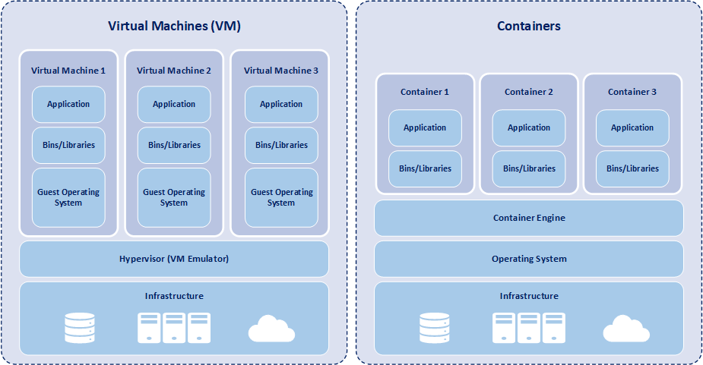
DevOps Internship
Team #5
VIRTUALIZATION
CONTAINERIZATOIN
VS
Use hypervisors (VMware, VirtualBox)
Heavyweight
Slower performance
Reserve dedicated system resources when running
Use container engine (Docker,..)
Lightweight
Near-Native performance
Share system resources dynamically

Slide 3
DevOps Internship
Team #5
LINUX NAMESPACES & CGROUPS V2 – OVERVIEW
Linux namespaces and control groups (cgroups) are the core technologies behind container isolation and resource control. Together, they enable containers to behave like independent systems while sharing the same host kernel.
Linux namespaces:
Namespaces isolate system resources for individual processes, so each container sees its own "mini" version of the operating system. Namespaces make containers feel like separate operating systems, even though they're sharing the same kernel.
The six major namespaces:
PID (Process ID): Isolates process IDs so that a process in one container sees only its own PID space, starting from 1.
NET (Network): Provides each container with its virtual network stack, including an IP address, routing table, and ports.
IPC (Interprocess Communication): Isolates communication methods, such as message queues and semaphores, so that processes can't interfere with each other.
UTS (UNIX Timesharing System): Let containers set their own hostname and domain name independently of the host.
MNT (Mount): Isolates file system mount points, giving each container a unique view of the file system.
USER: Maps user and group IDs inside the container to different values on the host, enabling unprivileged containers to run safely.
cgroups v2:
In cgroups v2, all resources are managed through a unified hierarchy, improving performance and simplifying configuration. It ensures that containers can't starve the system or each other by setting quotas, limits, and priorities.

Slide 4

DevOps Internship
Team #5
DOCKER 🐋
what is Docker?
Docker is an open platform for developing, shipping, and running applications
Docker enables you to separate your applications from your infrastructure so you can deliver software quickly.
With Docker, you can manage your infrastructure in the same ways you manage your applications. By taking advantage of Docker's methodologies for shipping, testing, and deploying code, you can significantly reduce the delay between writing code and running it in production.

Slide 5
DevOps Internship
🐋INSTALL DOCKER
Team #5
Commands to install Docker on Linux “Ubuntu
sudo apt update
sudo apt install apt-transport-https ca-certificates curl software-properties-common
curl -fsSL https://download.docker.com/linux/ubuntu/gpg | sudo apt-key add -
sudo add-apt repository “deb[arch=amd64] https://download.docker.com/linux/ubuntu focal stable”
sudo apt update
apt-cache policy docker-ce
sudo apt install docker-ce
You can install Docker Desktop on Windows

Slide 6
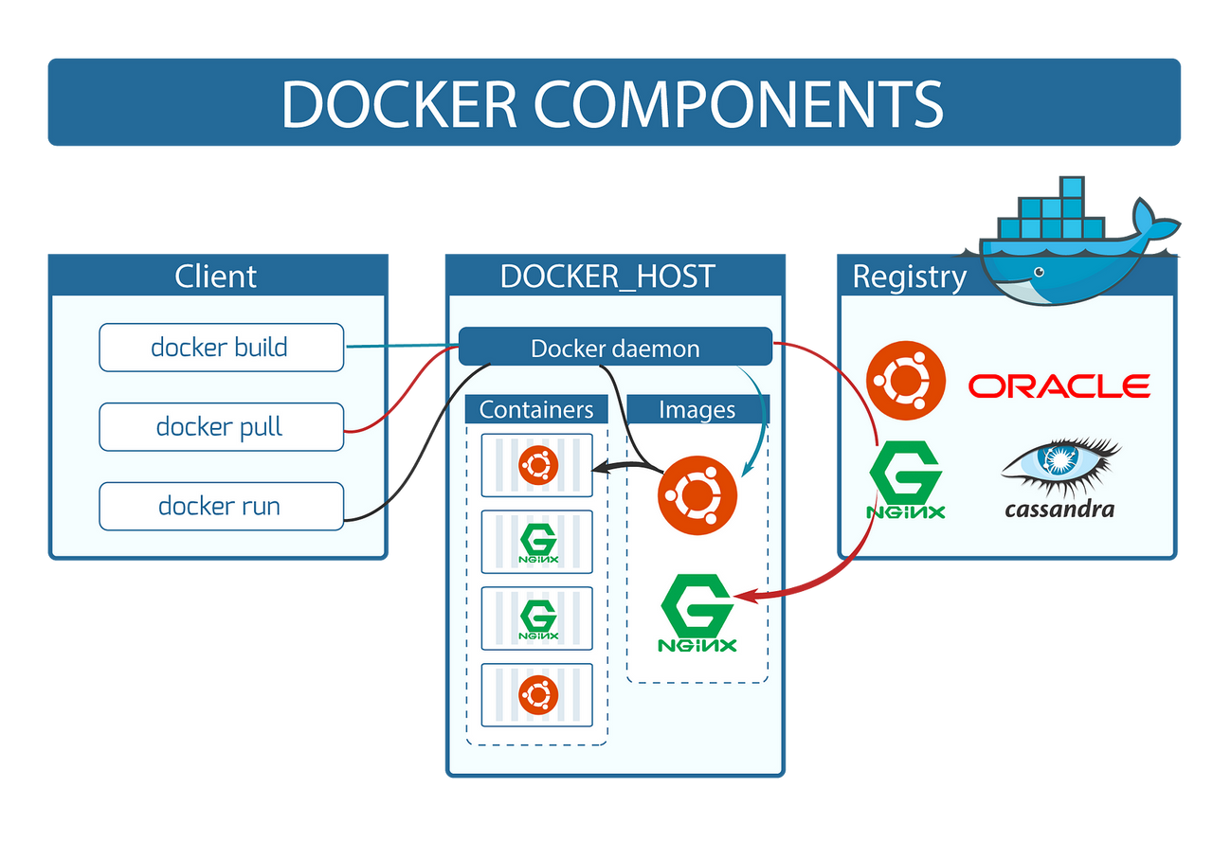
DevOps Internship
🐋DOCKER DAEMON
Team #5
what is Docker Daemon?
It acts as a bridge between the Docker client and the Docker engine, following the Client-Server Architecture.
Docker daemon executes commands issued by the client by translating them into actionable operations within the Docker environment.
Communication between the client and daemon happens via a RESTful API, typically over a Unix socket or network socket.

Slide 7


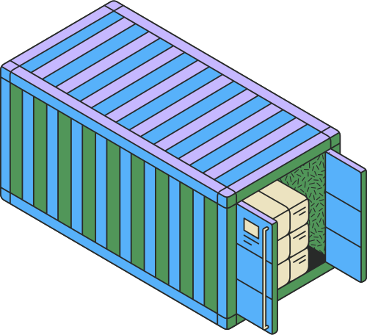
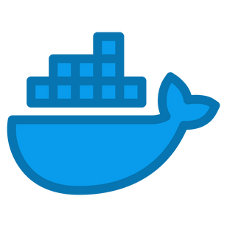
DevOps Internship
🐋DOCKER IMAGE
Team #5
what is a Docker Image?
An image is a standardized package that includes all of the files, binaries, libraries, and configurations to run a container.
There are two important principles of images:
Images are immutable. Once an image is created, it can't be modified. You can only make a new image or add changes on top of it.
Container images are composed of layers. Each layer represents a set of file system changes that add, remove, or modify files.
These two principles let you to extend or add to existing images.
Essential Docker Image Commands:
Pull an Image from Docker Hub: docker pull IMAGE_NAME
List All Images on Your System: docker images
Build an Image from a Dockerfile: docker build -t IMAGE_NAME PATH
build
run
Dockerfile
Docker image
Docker container

Slide 8
DevOps Internship
🐋DOCKER CONTAINER
Team #5
what is a Docker container?
A container is simply an isolated process with all of the files it needs to run.
Running containers share the same kernel, allowing you to run more applications on less infrastructure.
Here's what makes them awesome. Containers are:
Self-contained 2- Isolated 3- Independent 4- Portable
Essential Docker Container Commands:
Create and Start a Container: docker run IMAGE_NAME
List Running Containers: docker ps
List All Containers (including stopped): docker ps -a
Stop a Running Container: docker ps CONTAINER_ID_OR_NAME
Start a Stopped Container: docker stop CONTAINER_ID_OR_NAME
Remove a Stopped Container: docker rm CONTAINER_ID_OR_NAME
Access a Running Container’s Shell: docker exec -it CONTAINER_NAME bash
running
paused
exiting
restarting
Container life cycle

Slide 9
DevOps Internship
🐋DOCKERFILE
Team #5
what is a Dockerfile?
A Dockerfile is a text document that contains all the commands a user could call on the command line to assemble an image
It tells Docker how to create an image step by step, including the base image, installed packages, copied files, and commands to run.
why is it important?
Automates the creation of consistent, repeatable environments
Helps package your app with everything it needs (code, runtime, configs)
Makes it easy to share and deploy across machines or teams
Common Dockerfile Instructions:
Instructions | Descreption
FROM | specifies the base image
RUN | Executes commands in the container during image build (e.g., installing packages)
COPY | Copies files into the image
WORKDIR | Sets the working directory
EXPOSE | Documents the port the container listens on
ENV | Sets environment variables inside the image
CMD | Specifies the default command when the container starts

Slide 10
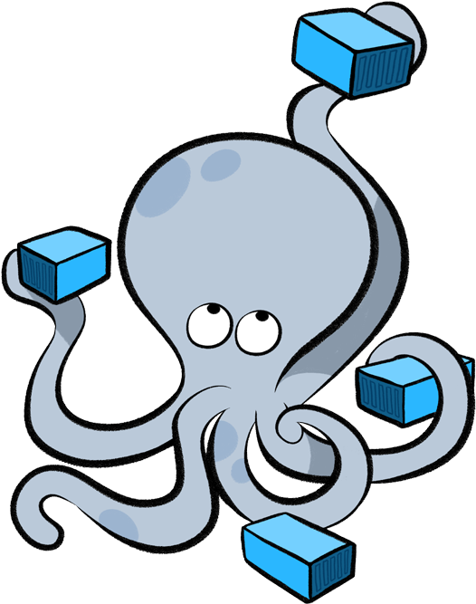
DevOps Internship
🐙DOCKER COMPOSE
Team #5
what is a Docker Compose?
Docker Compose is a tool for defining and running multi-container applications.
simplifies the control of your entire application stack, making it easy to manage services, networks, and volumes in a single YAML configuration file.
Then, with a single command, you create and start all the services from your configuration file.
why is it important?
Manages multiple services (e.g.,web+database) easily.
Allows you to start all services with one command.
Simplifies configuration of networks, volumes, ports, and dependencies
Essential Docker Container Commands:
To start all the services: docker-compose up
To stop services and clean up : docker-compose down
List running services: docker-compose ps

Slide 11
DevOps Internship
Team #5
REFERENCES
https://docs.docker.com/
https://www.geeksforgeeks.org/
Live session #4 slides @sprints platform

Slide 12
THANK YOU!

